Slide 1
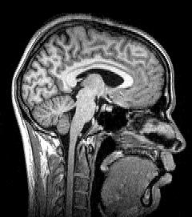
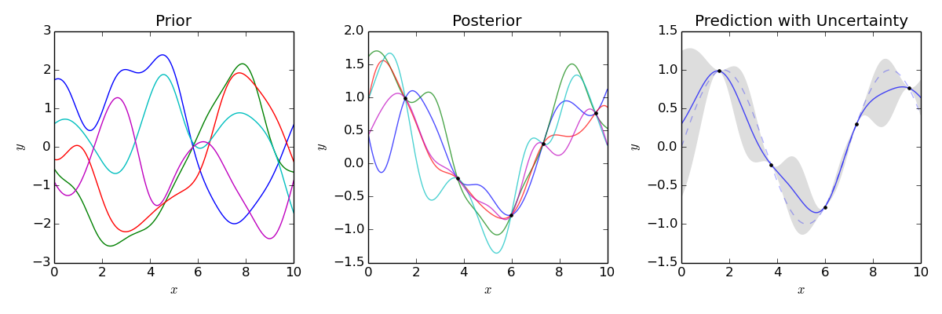
Gaussian Process Interpolation for Uncertainty Estimation in Image Registration
ECSE 626 - Project presentation
Notes:
Diagnostic précoce de la maladie de Parkinson
Par classification automatique et modèle de prédiction

Slide 2
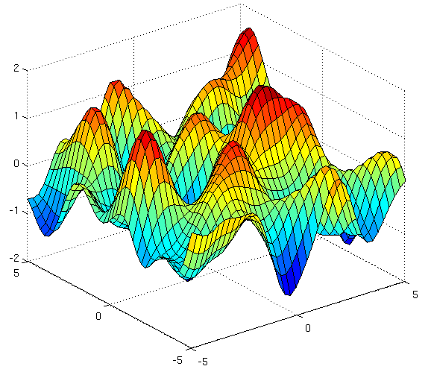
Guideline
Image Registration
Gaussian process Interpolation
Method
Preliminary Results

Slide 3

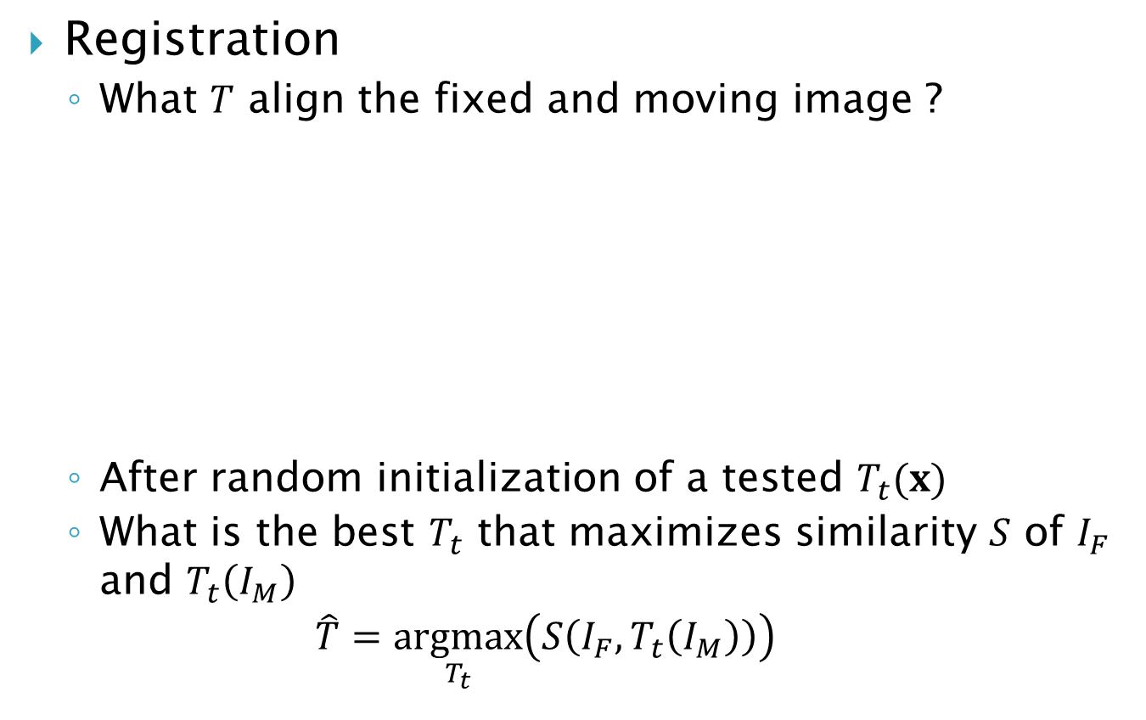


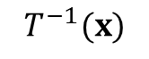
Image registration
Registration
What $T$ align the fixed and moving image ?
After random initialization of a tested $T_{t}(x)$
What is the best $T_{t}$ that maximizes similarity $S$ of $I_{F}$ and $T_{t}\left(I_{M}\right)$
$$\hat{T}=\underset{T_{t}}{argmax}\left(S\left(I_{F},T_{t}\left(I_{M}\right)\right)\right)$$
$$I_{M}$$
$$I_{F}$$
$$T^{−1}(x)$$

Slide 4
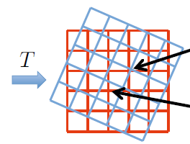
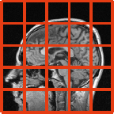
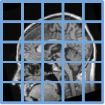
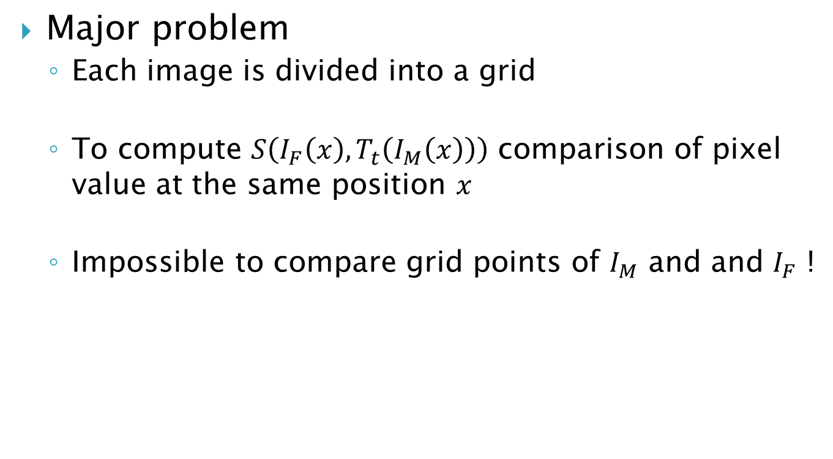
Image registration
Major problem
Each image is divided into a grid
To compute $S\left(I_{F}\left(x\right),T_{t}\left(I_{M}\left(x\right)\right)\right)$ comparison of pixel value at the same position $x$
Impossible to compare grid points of $I_{M}$ and and $I_{F}$ !
[1]

Slide 5
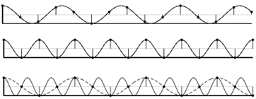
Image Registration
Interpolation :
Construction of the continuous version of a discrete signal
Convolution with a kernel through all the observations
Interpolator with Nyquist frequency [2]
fe > fs/2
https://commons.wikimedia.org/wiki/File:Nyquist_Aliasing.svg

Slide 6
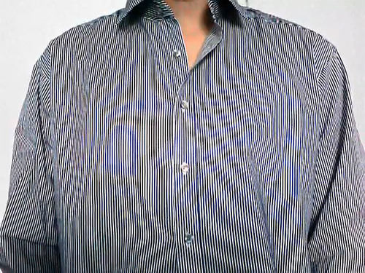
Image registration
Example of aliased image (too low image resolution for the details)
https://commons.wikimedia.org/wiki/File:Nyquist_Aliasi http://forum.hardware.fr/hfr/VideoSon/Traitement-Video/unik-artefacts-videos-sujet_142007_1.htm ng.svg

Slide 7
Image registration
Quadratic interpolation
-2
-1
0
1
2

Slide 8
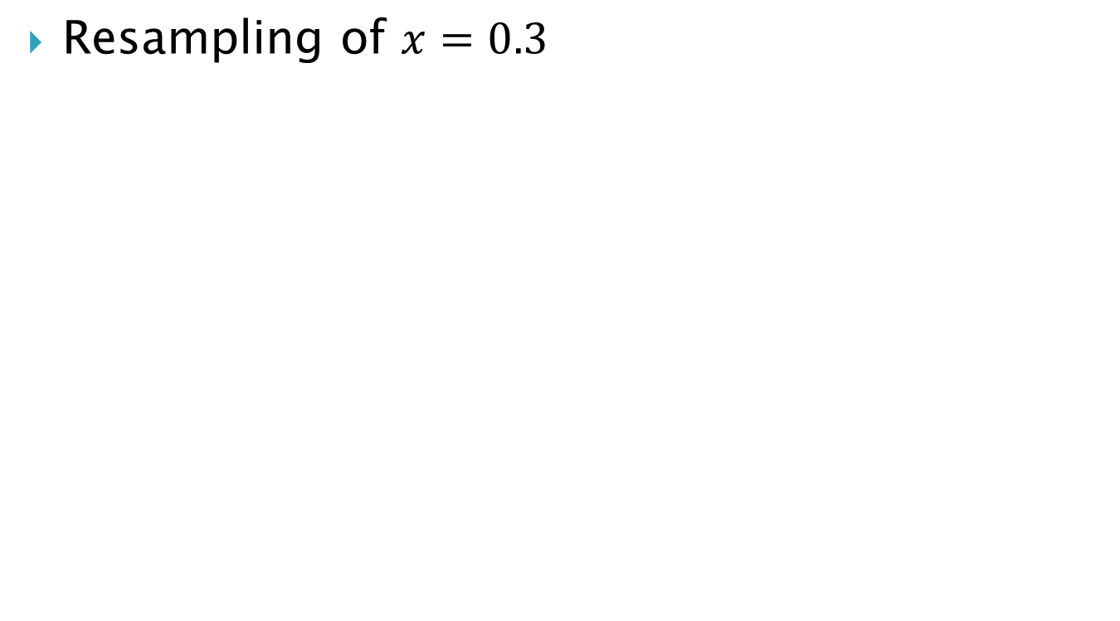
Image registration
Resampling of $x=0.3$
-2
-1
0
1
2

Slide 9
Image registration
Interpolated values
-2
-1
0
1
2

Slide 10
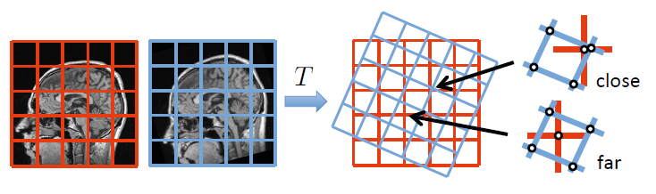
Image registration
Drawback of all the approaches
Difficult because interpolation error varies among grid points
How to model the interpolation uncertainty ?

Slide 11
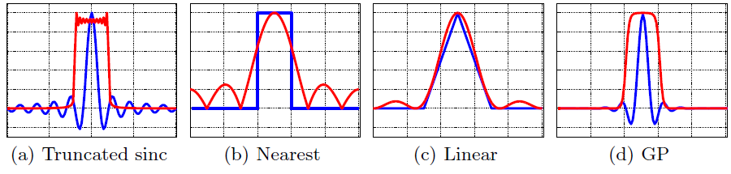
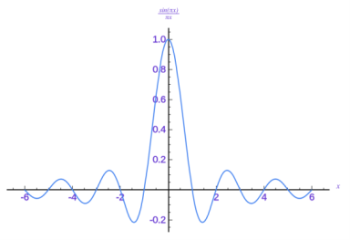
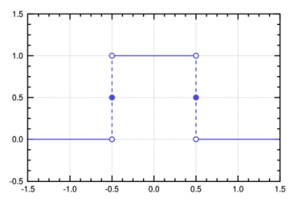
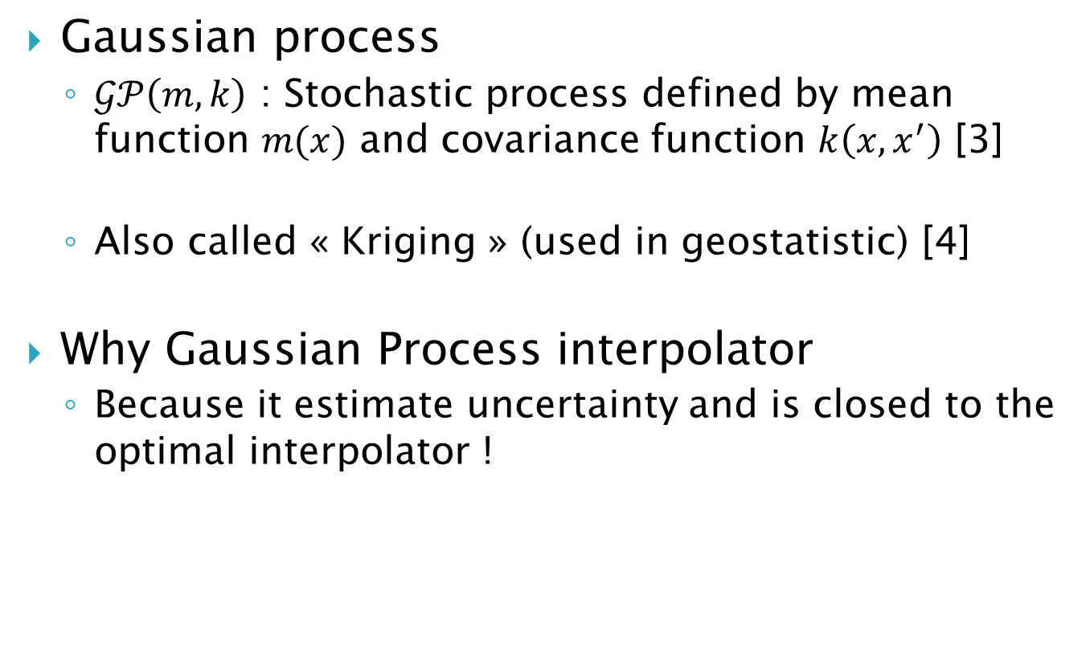
Gaussian Process Interpolation
Gaussian process
$𝒢𝒫\left(m,k\right)$ : Stochastic process defined by mean function $m(x)$ and covariance function $k\left(x,x^{′}\right)$ [3]
Also called « Kriging » (used in geostatistic) [4]
Why Gaussian Process interpolator
Because it estimate uncertainty and is closed to the optimal interpolator !

Slide 12
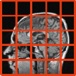
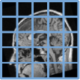
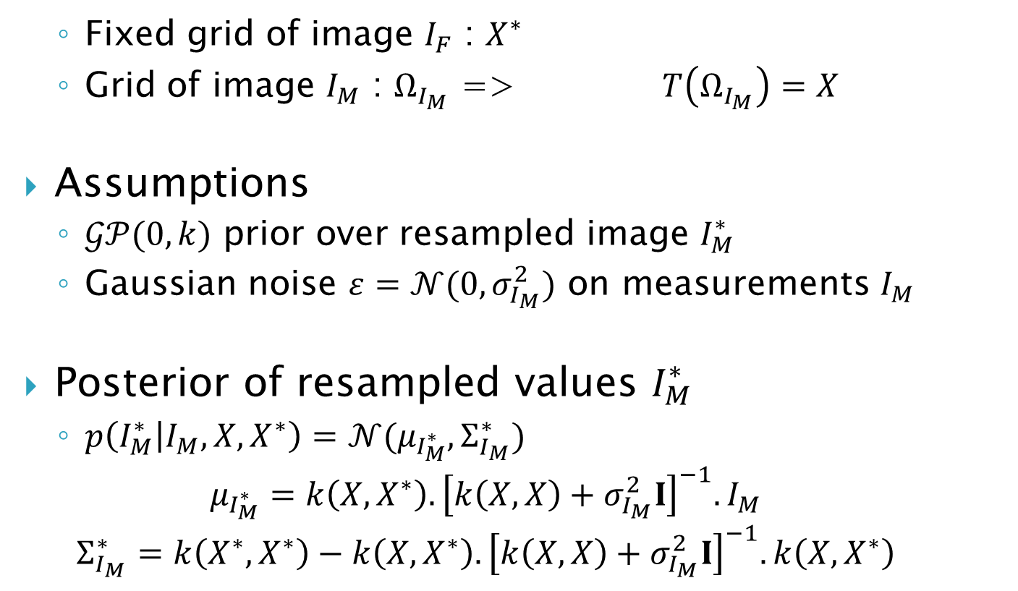
Method : Bayesian Regression
Fixed grid of image $I_{F}$ : $X^{∗}$
Grid of image $I_{M}$ : $Ω_{I_{M}}$ => $T\left(Ω_{I_{M}}\right)=X$
Assumptions
$𝒢𝒫(0,k)$ prior over resampled image $I_{M}^{∗}$
Gaussian noise $ε=𝒩(0,σ_{I_{M}}^{2})$ on measurements $I_{M}$
Posterior of resampled values $I_{M}^{∗}$
$p\left(I_{M}^{∗} | I_{M},X,X^{∗}\right)=$ $𝒩(μ_{I_{M}^{∗}},Σ_{I_{M}}^{∗})$
$$μ_{I_{M}^{∗}}=k\left(X,X^{∗}\right).{\left[k\left(X,X\right)+σ_{I_{M}}^{2}I\right]}^{−1}.I_{M}$$
$$Σ_{I_{M}}^{∗}=k\left(X^{∗},X^{∗}\right)−k\left(X,X^{∗}\right).{\left[k\left(X,X\right)+σ_{I_{M}}^{2}I\right]}^{−1}.k\left(X,X^{∗}\right)$$

Slide 13
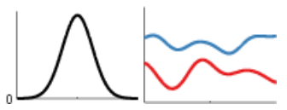
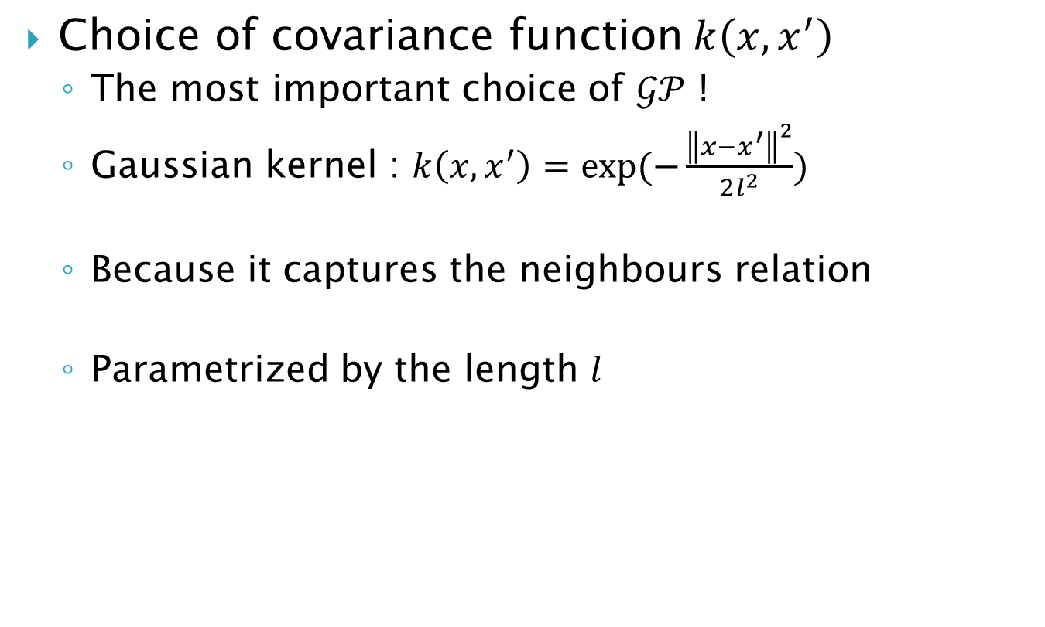
Method : Bayesian Regression
Choice of covariance function$k\left(x,x^{′}\right)$
The most important choice of $𝒢𝒫$ !
Gaussian kernel : $k\left(x,x^{′}\right)=\exp{(−\frac{{\left\|x−x^{′}\right\|}^{2}}{2l^{2}})}$
Because it captures the neighbours relation
Parametrized by the length $l$
http://people.seas.harvard.edu/~dduvenaud/cookbook/

Slide 14
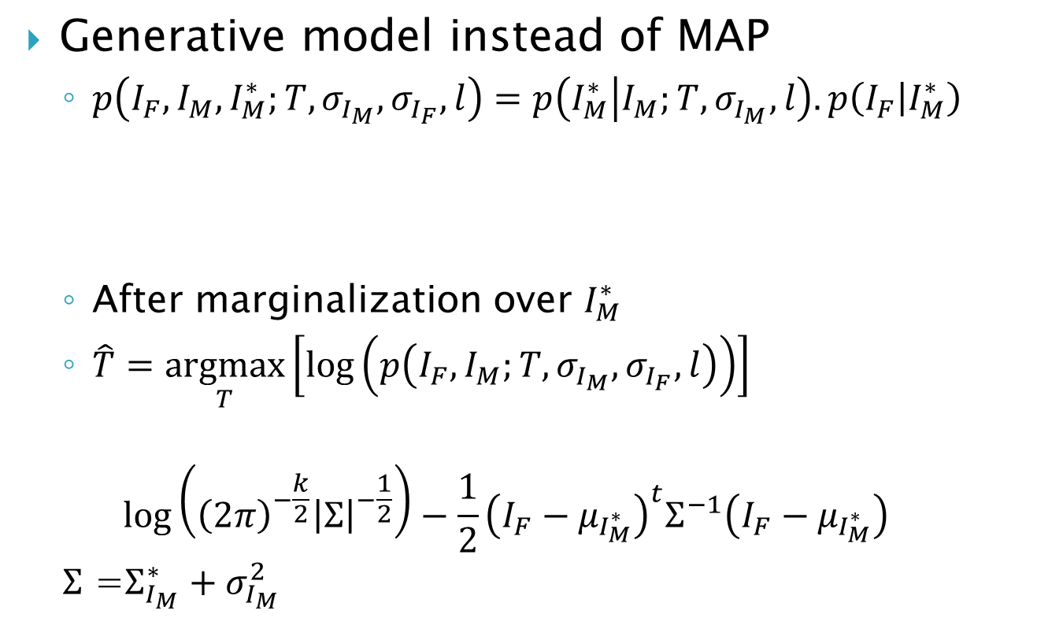
Method : Similarity measure
Generative model instead of MAP
$p\left(I_{F},I_{M},I_{M}^{∗};T,σ_{I_{M}},σ_{I_{F}},l\right)=p\left(I_{M}^{∗} | I_{M};T,σ_{I_{M}},l\right).p\left(I_{F} | I_{M}^{∗}\right)$
After marginalization over $I_{M}^{∗}$
$\hat{T}=\underset{T}{argmax}\left[\log\left(p\left(I_{F},I_{M};T,σ_{I_{M}},σ_{I_{F}},l\right)\right)\right]$
$$\log\left({\left(2π\right)}^{−\frac{k}{2}}{\left|Σ\right|}^{−\frac{1}{2}}\right)−\frac{1}{2}{\left(I_{F}−μ_{I_{M}^{∗}}\right)}^{t}Σ^{−1}\left(I_{F}−μ_{I_{M}^{∗}}\right)$$
$Σ$ =$Σ_{I_{M}}^{∗}+σ_{I_{M}}^{2}$
Previous posterior Likelihood

Slide 15
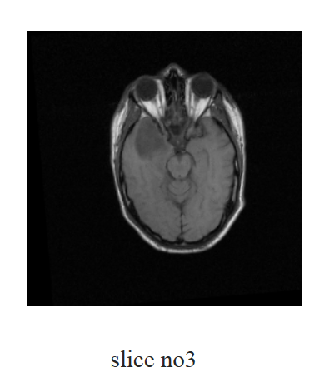
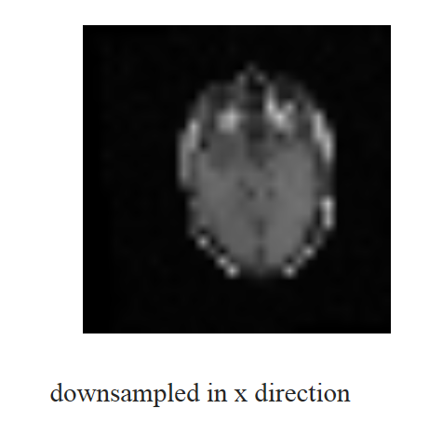
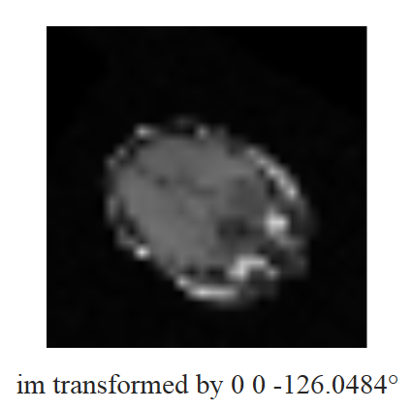
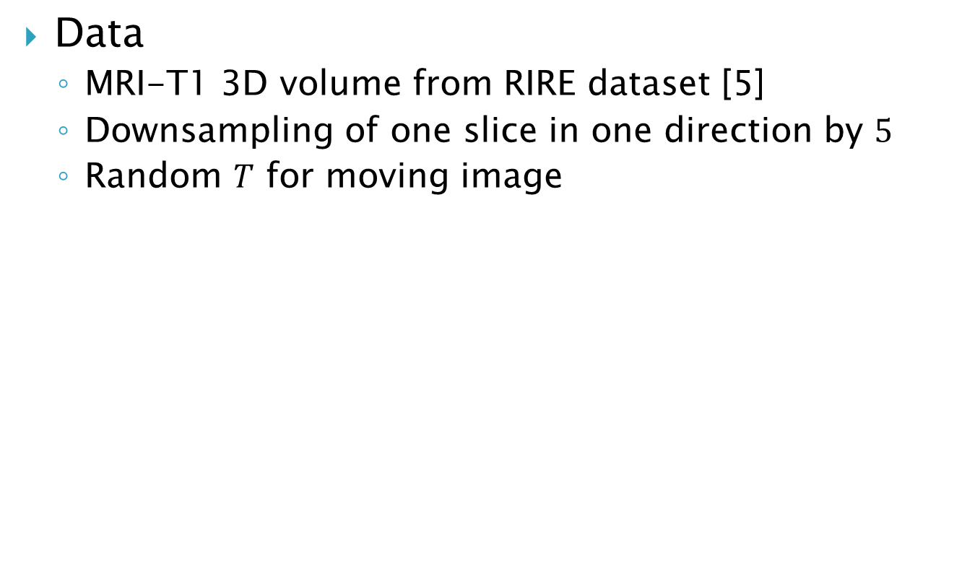
Preliminary results
Data
MRI-T1 3D volume from RIRE dataset [5]
Downsampling of one slice in one direction by $5$
Random $T$ for moving image

Slide 16
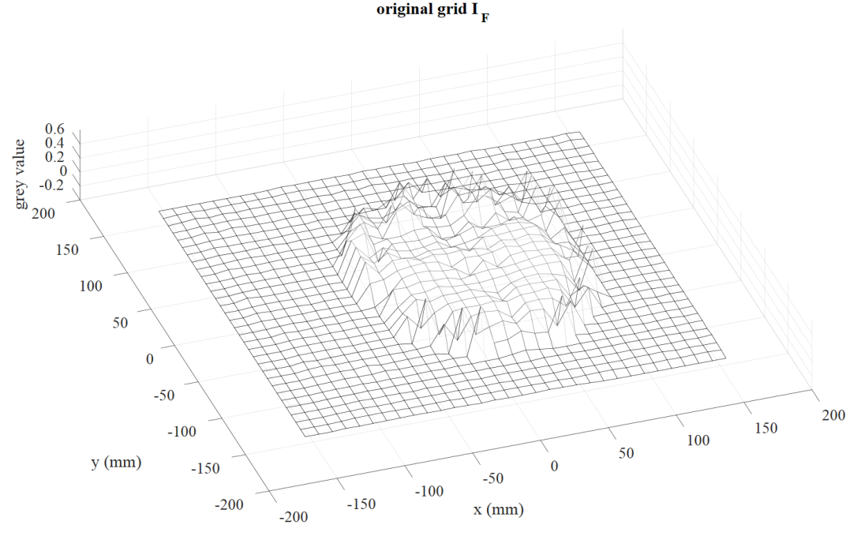
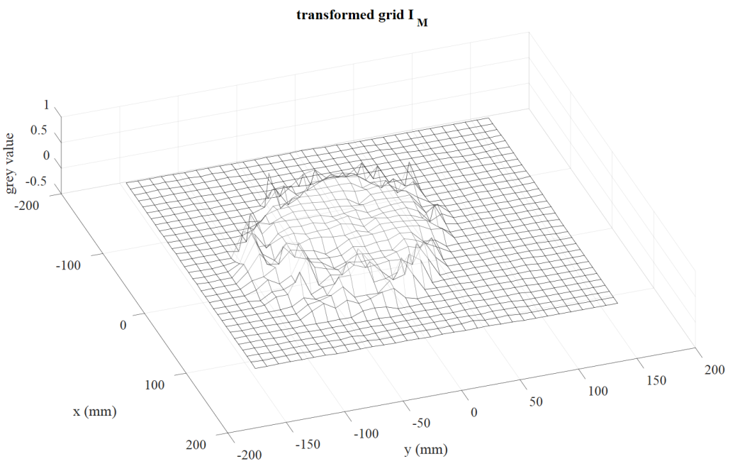
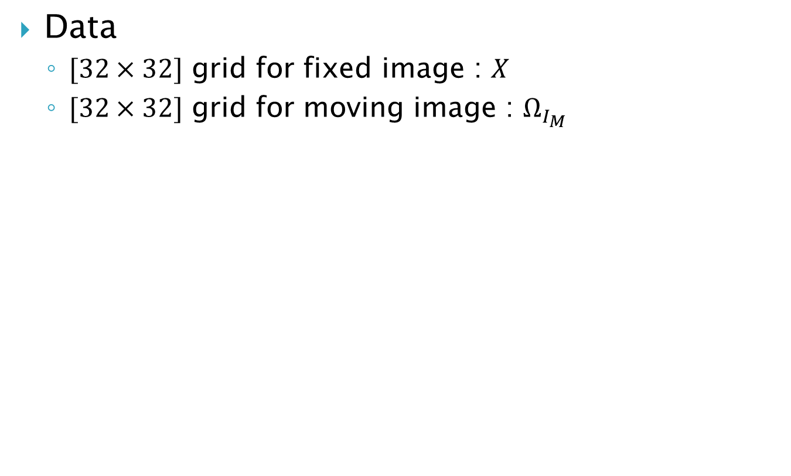
Preliminary results
Data
$[32×32]$ grid for fixed image : $X$
$[32×32]$ grid for moving image : $Ω_{I_{M}}$

Slide 17
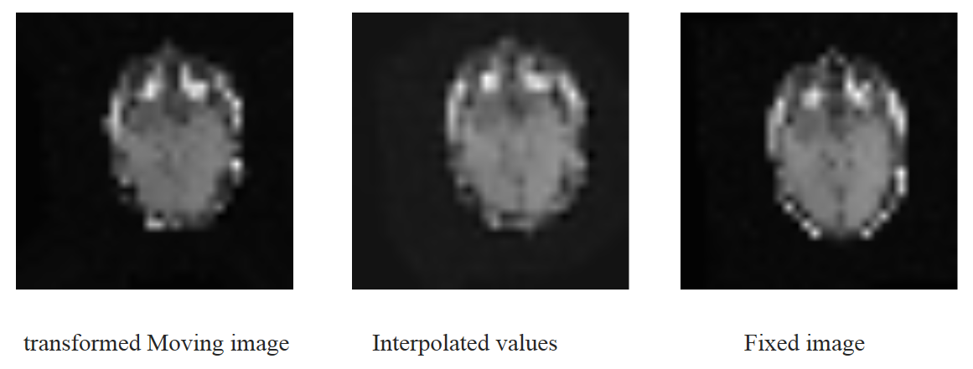

Preliminary results
Interpolation results
With lengthscale $l=6,25$ and noise $σ_{I_{M}}=0,1$

Slide 18
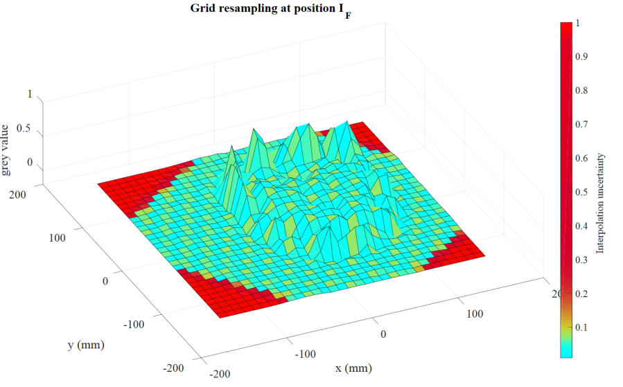
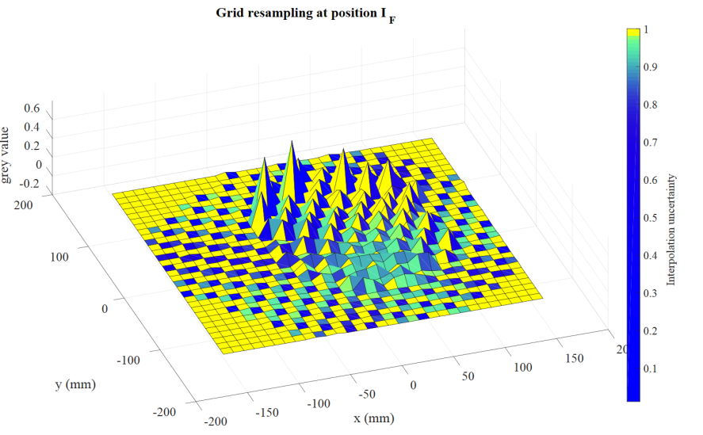
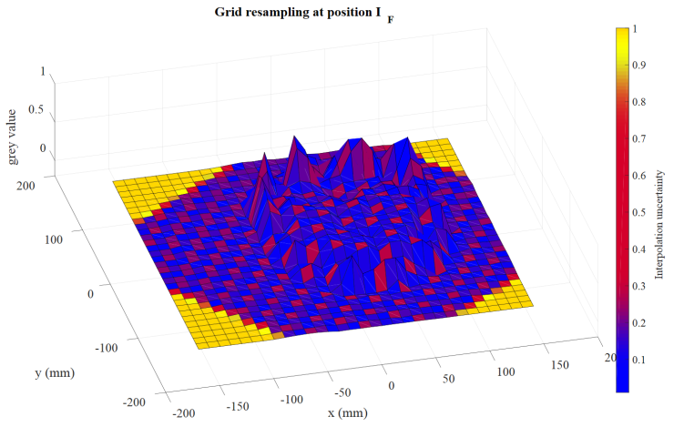
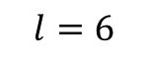
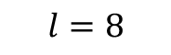

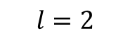
Preliminary results
Interpolation results
Influence of $l$ : smoothness and uncertainty
$$l=8$$
$$l=2$$
$$l=6$$

Slide 19
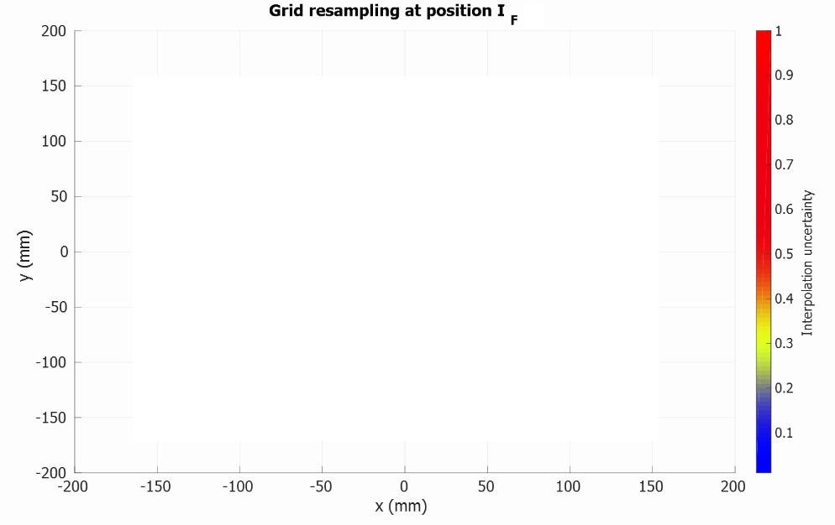
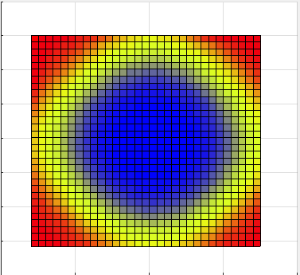
Preliminary results
Influence of rotation

Slide 20
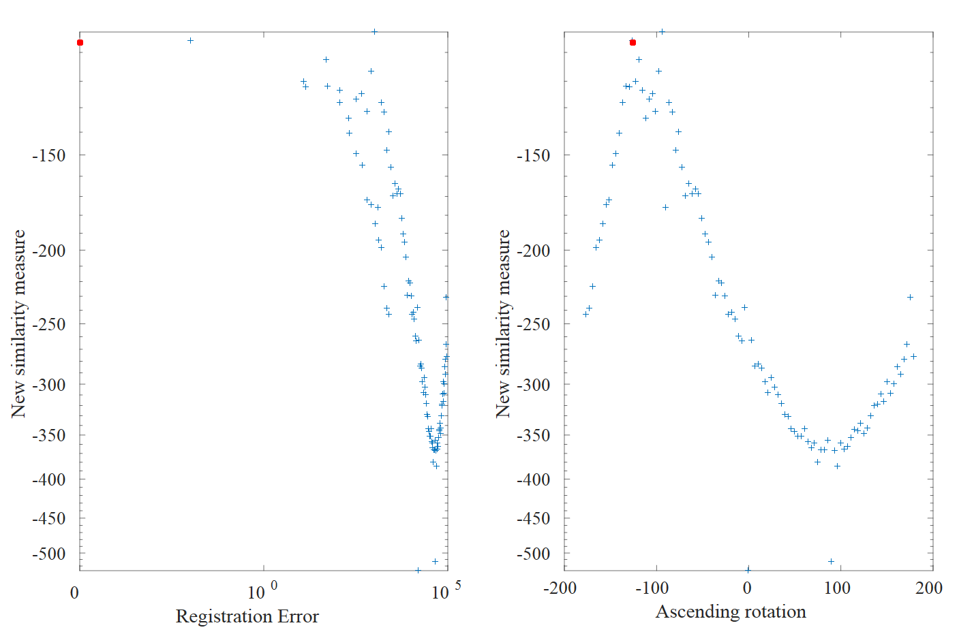

Preliminary results
Cost function
Test with $T_{x}=0 ; T_{y}=0 ; T_{θ_{z}}=−106°$
True transformation

Slide 21
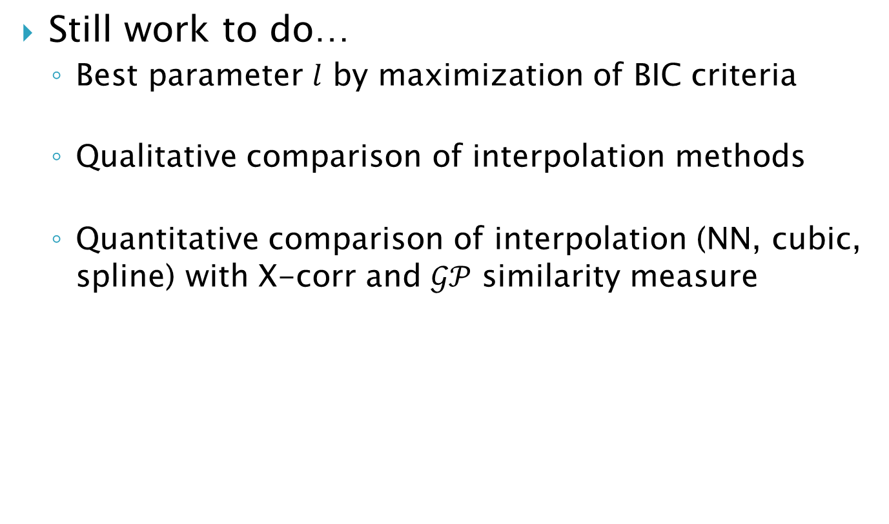
Future work
Still work to do…
Best parameter $l$ by maximization of BIC criteria
Qualitative comparison of interpolation methods
Quantitative comparison of interpolation (NN, cubic, spline) with X-corr and $𝒢𝒫$ similarity measure

Slide 22
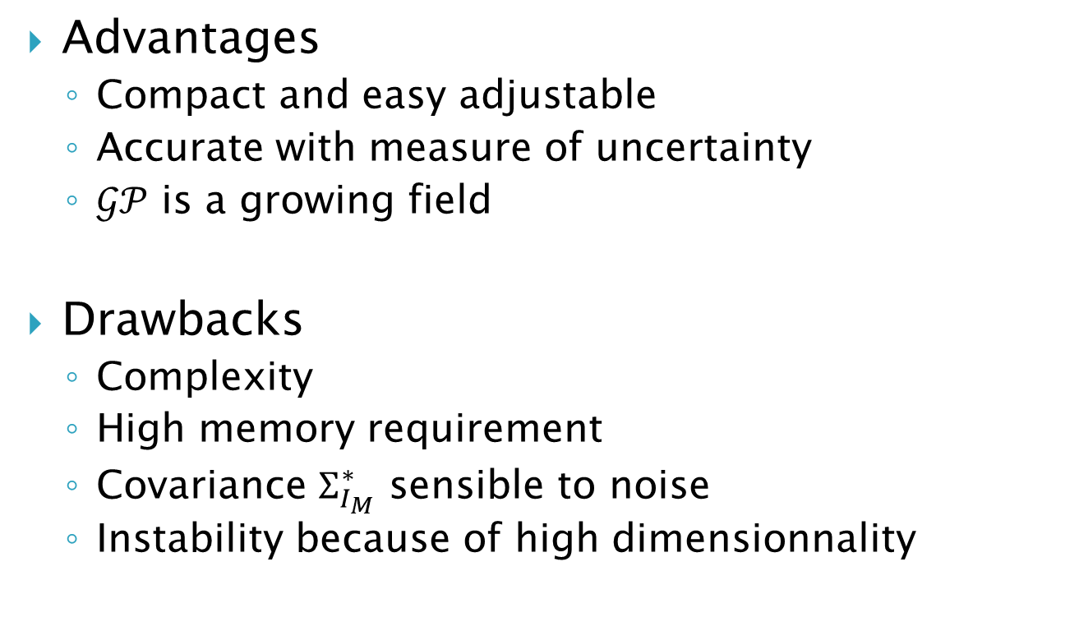
Conclusion
Advantages
Compact and easy adjustable
Accurate with measure of uncertainty
$𝒢𝒫$ is a growing field
Drawbacks
Complexity
High memory requirement
Covariance $Σ_{I_{M}}^{∗}$ sensible to noise
Instability because of high dimensionnality

Slide 23
References
[1] Wachinger, Christian, et al. "Gaussian process interpolation for uncertainty estimation in image registration." Medical Image Computing and Computer-Assisted Intervention–MICCAI 2014. Springer International Publishing, 2014. 267-274.
[2] Lehmann, Thomas M., Claudia Gönner, and Klaus Spitzer. "Survey: Interpolation methods in medical image processing." Medical Imaging, IEEE Transactions on 18.11 (1999): 1049-1075.
[3] Rasmussen, Carl Edward. "Gaussian processes for machine learning." (2006).
[4] Van Beers, Wim, and Jack PC Kleijnen. "Kriging interpolation in simulation: a survey." Simulation Conference, 2004. Proceedings of the 2004 Winter. Vol. 1. IEEE, 2004.
[5] Fitzpatrick, J. Michael, Jay B. West, and Calvin R. Maurer Jr. "Predicting error in rigid-body point-based registration." Medical Imaging, IEEE Transactions on 17.5 (1998): 694-702.

Slide 24
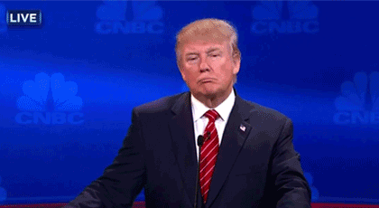
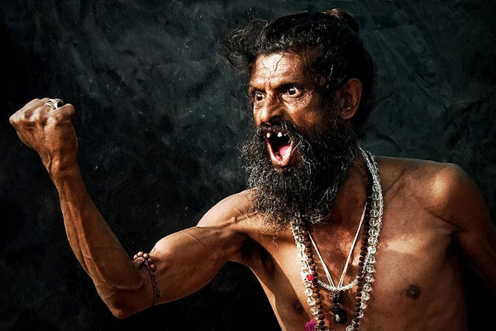
Discussion

Slide 25
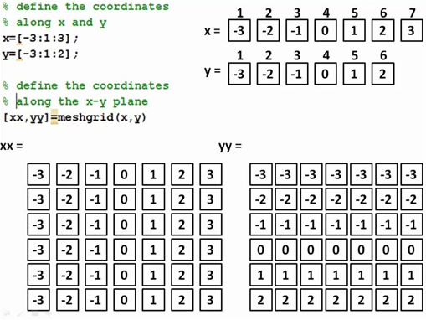
Annexe : Matrix computation on Matlab

